Slide 1
Capturing the Android Market with Data to Guide App Developers at Treelo Tech
Utilizing 2018 Google Play Store Dataset
Rona Masab
September 30 2020

Slide 2
Introduction:
Treelo Tech is a New York City based startup that specializes in mobile game development
Utilizing 2018 Google Play Store Dataset
Objective:
Investigate the features that Developers at Treelo Tech should focus on when creating a new app for the Android market

Slide 3
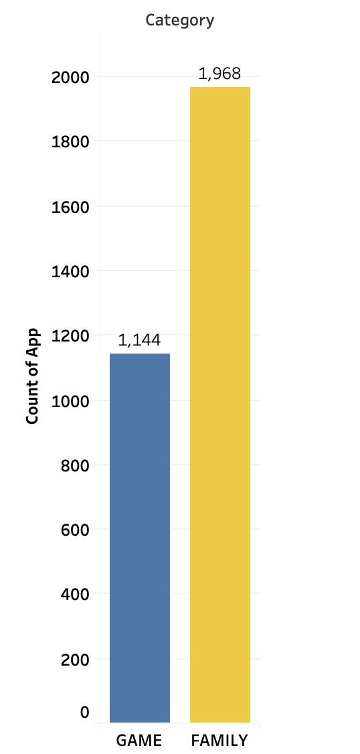
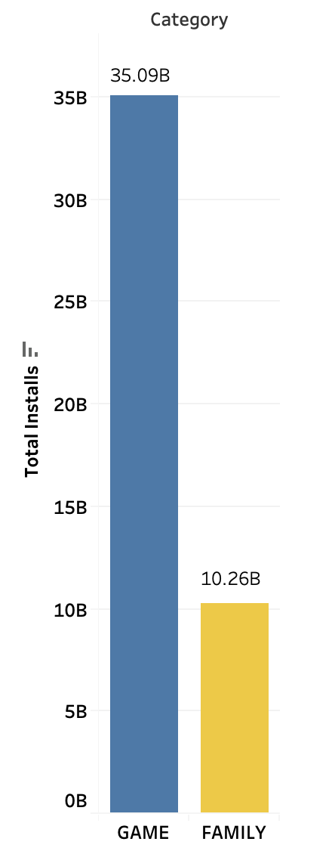
Top Google Play Store Categories
Number of Apps
Total Installs

Slide 4
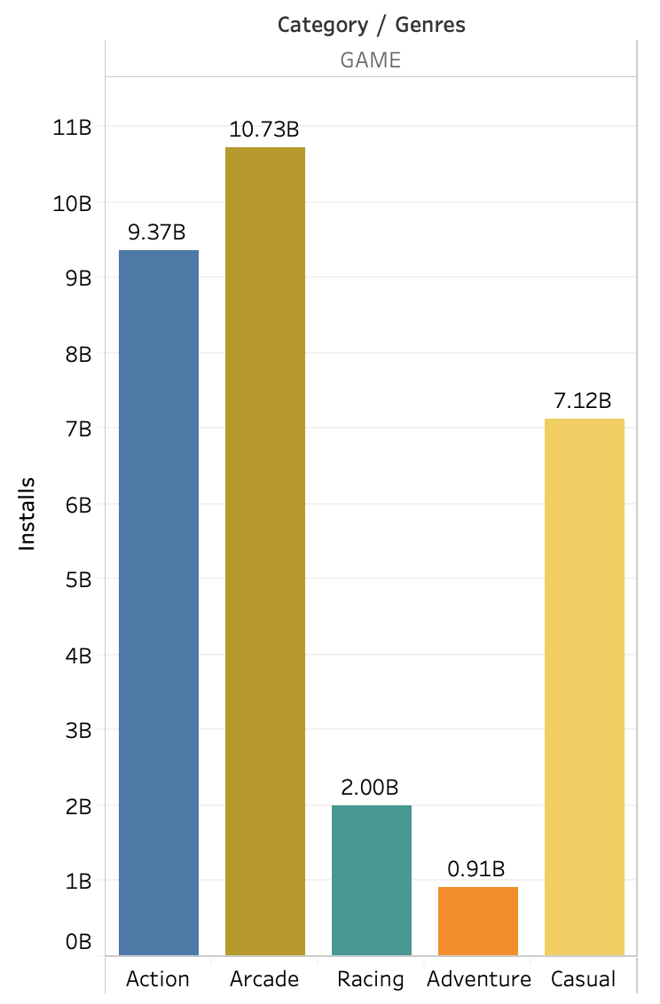
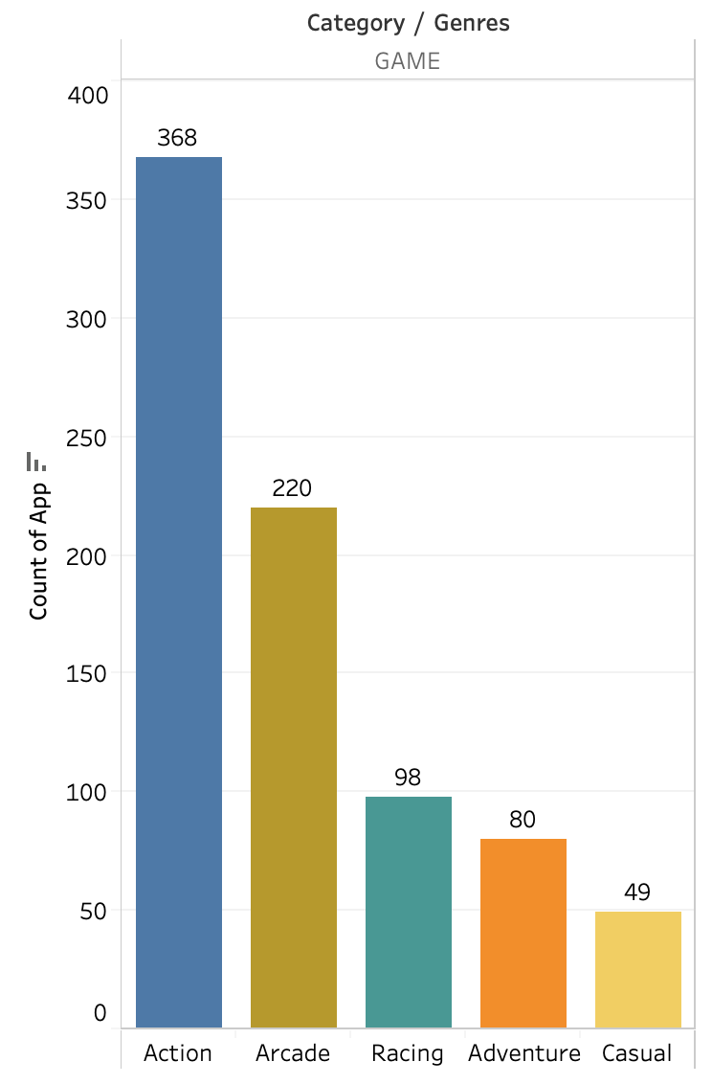
A Closer Look into the Game Category
Installs of Apps in Game Subcategory
Count of Apps in Game Subcategory

Slide 5


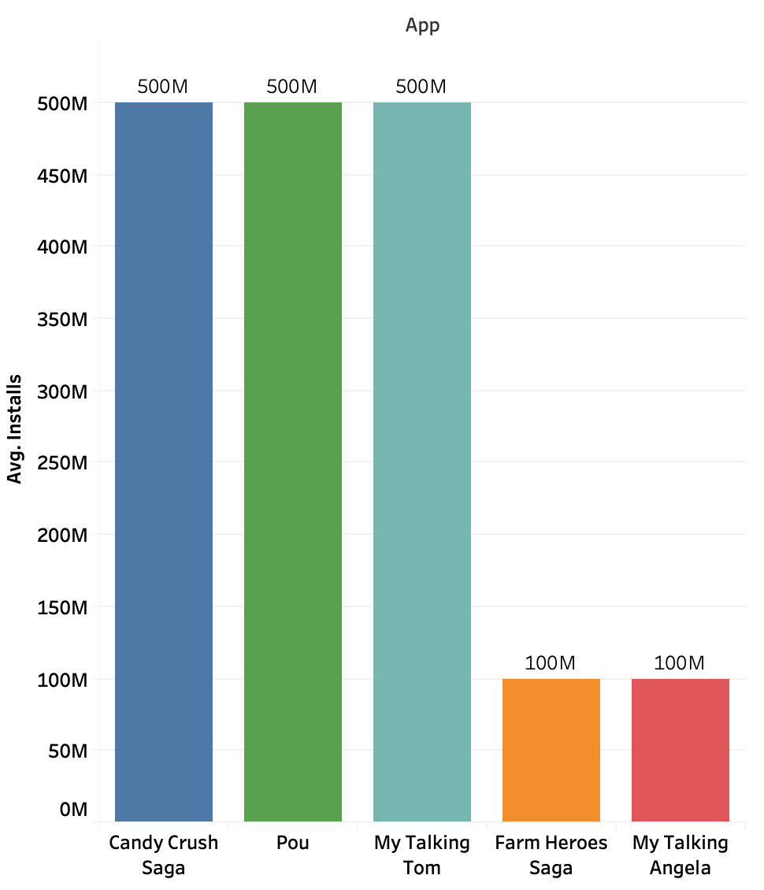



Examples of Popular Casual Games
Average Installs

Slide 6
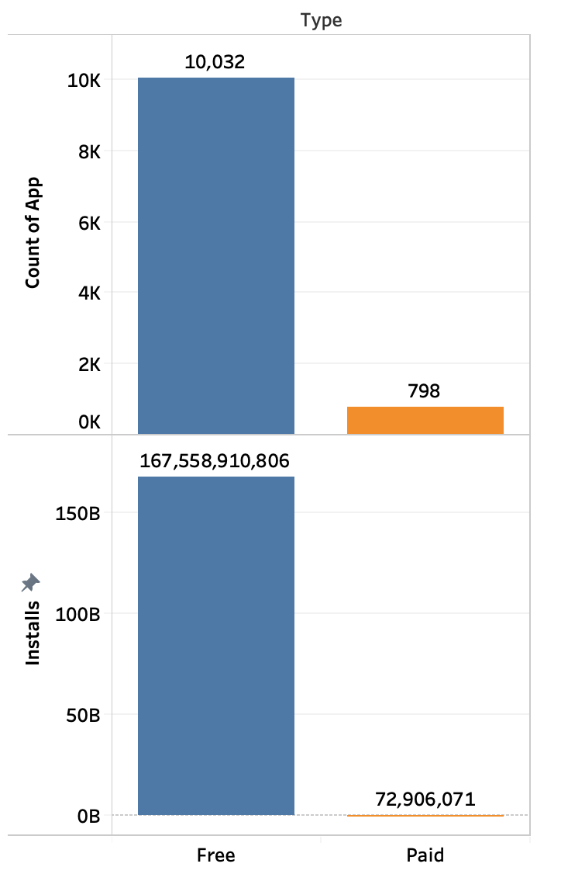
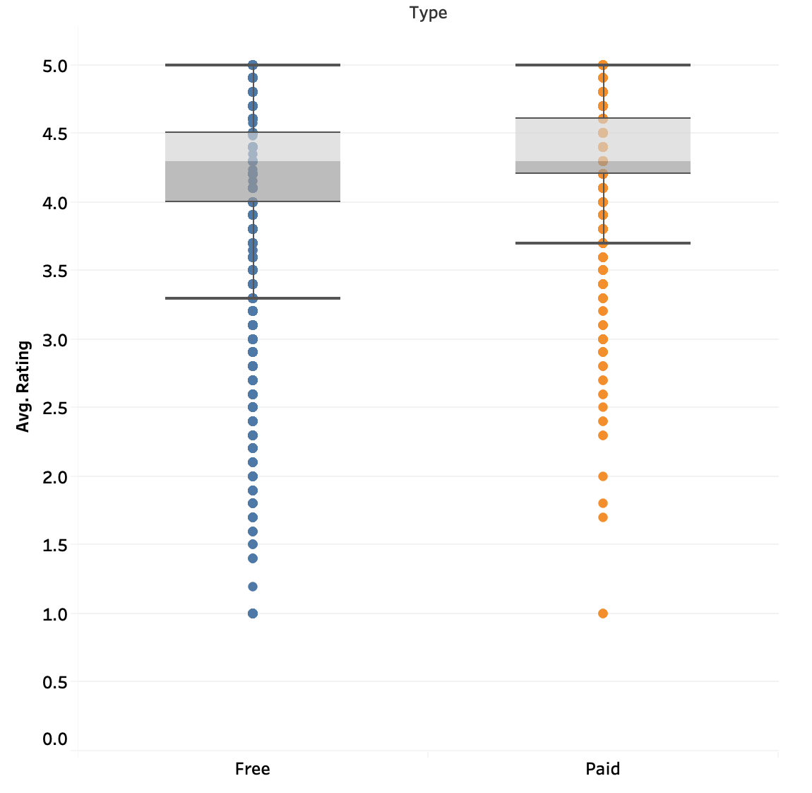
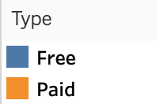
Pricing Strategy: Free or Paid?
Median Rating by Type

Slide 7
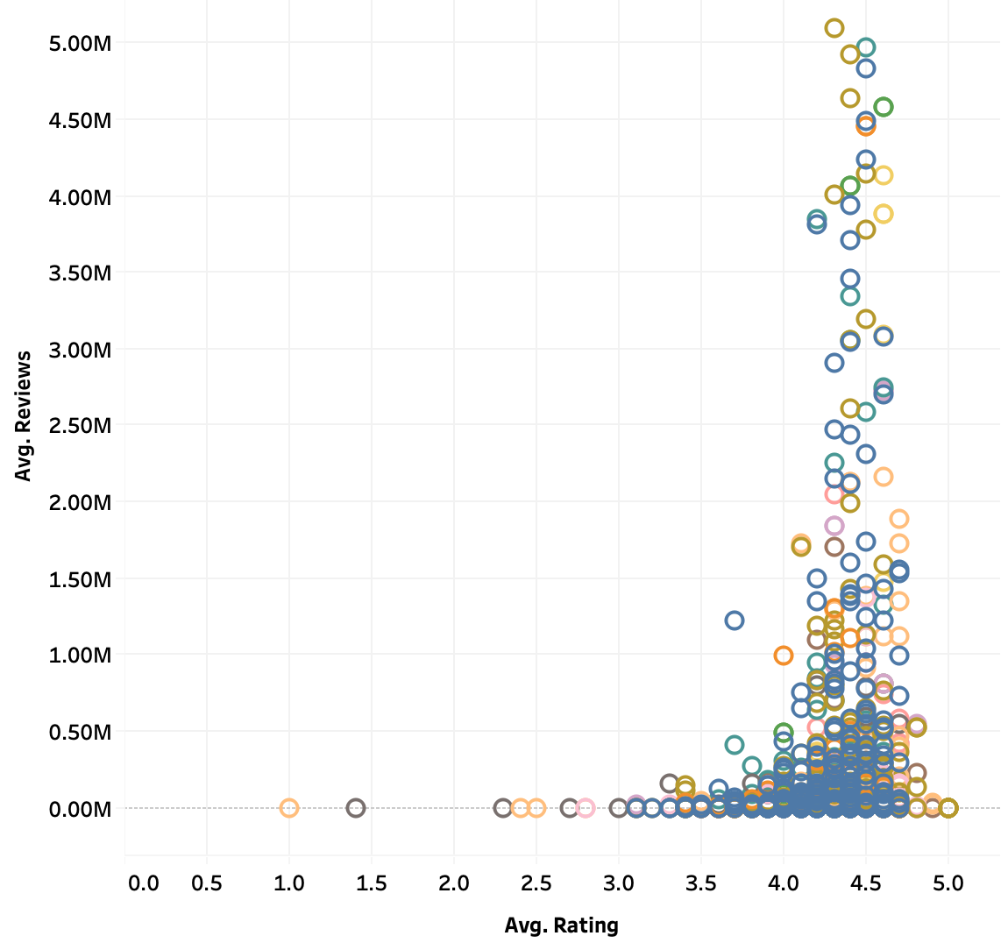
Encourage User Reviews to Boost Ratings
Average Ratings and Reviews

Slide 8
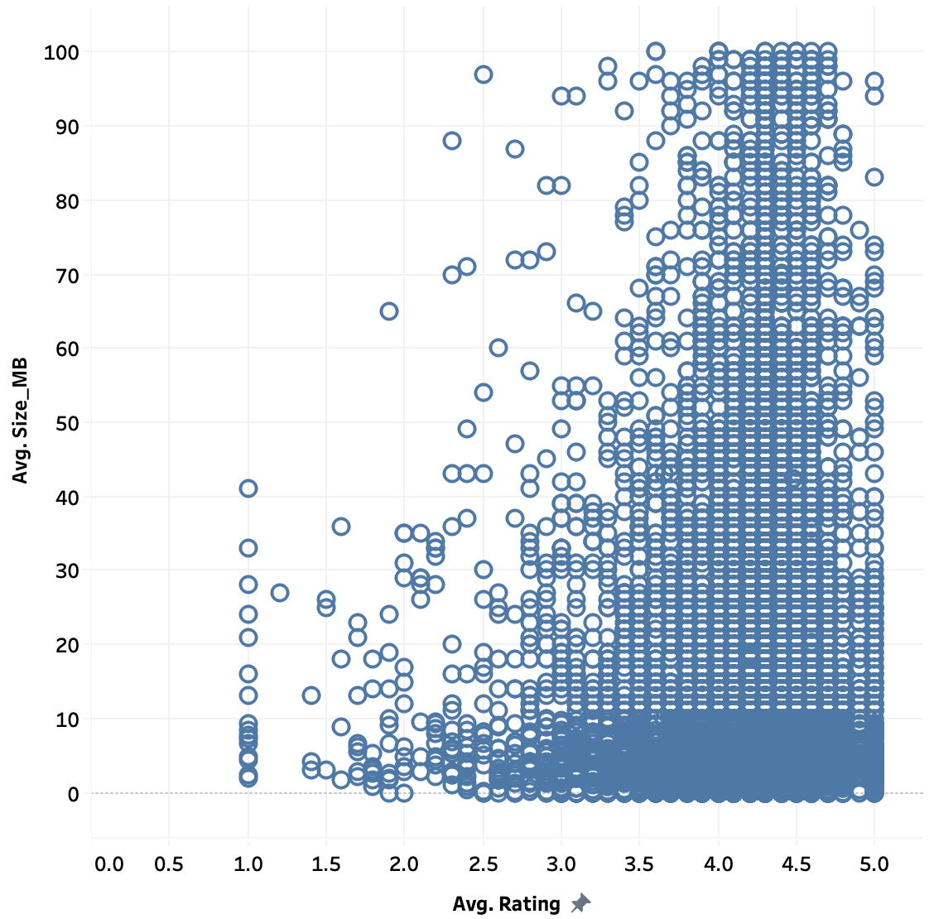
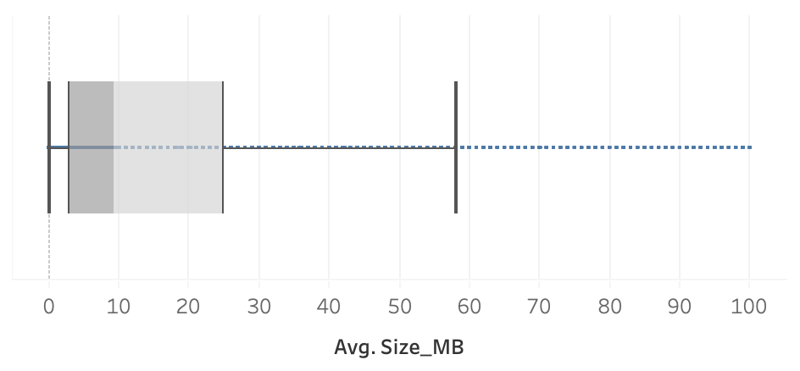
Bulky vs Light Weight Apps

Slide 9
Factors that Influence Rating
Size
Price
Reviews

Slide 10
Takeaways for Guiding App Development
Launch app into Casual Games genre
Keep app size light, under 30 MB.
Make app free
Encourage users to leave reviews; users install applications more if it has existing reviews

Slide 11
Next Steps
Investigate app retention to see how long users actually keep apps
Scrape reviews in the Google Play Store to analyze text data to get a better understanding about review types (positive or negative)
Investigate where to implement marketing efforts once app is developed

Slide 12
THANK YOU!
Email: Rmasab@gmail.com
Linkedin: linkedin.com/in/Rmasab
Github: github.com/Rmasab

Slide 13
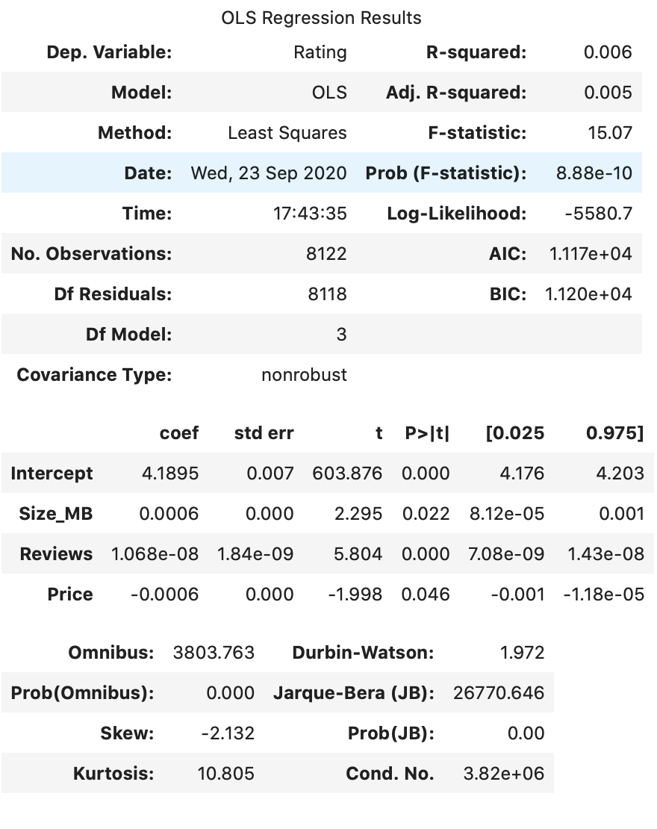
Appendix
Linear Regression Model
Link to Dataset: https://tinyurl.com/datasetcap4
Notes:
R-square value tells you how much variation is explained by your model.
R2 tell you the variation in your dependent(Rating) variable that is accounted for (or predicted by) your independent variables(Size, Reviews, Price)
In my model, although the model doesn't explain much of variation of the data, the variables are significant as we can see by their low p values.
The P value is a probability that tells you how confident you can be that each individual variable has some relationship with the dependent variable, which is the important thing.
These columns with a low p-value does impact the target variable
This reported value is used to establish the statistical significance of the relationships being tested.

